Slide 1

Research Progress Record
Enmao Diao
Dec 17, 2019

Slide 2
Overview
Restricted Multimodal Generative Model
Deep Adversarial Attacks Against Channel Coding
Restricted-Federated-Learning
Ultra-personalized-Content-Based-Recommendation-System

Slide 3
Restricted Multimodal Generative Model
Generate images from data with high modality
Omniglot (1623 different handwritten characters from 50 different alphabets)
CelebA (10,177 number of identities, 202,599 number of face images, and 5 landmark locations, 40 binary attributes annotations per image)
Generate Images for every character and every identity
Data with the same modality forms a cluster
Each cluster train separate model (naïve). Restrict them by sharing part of their parameters

Slide 4
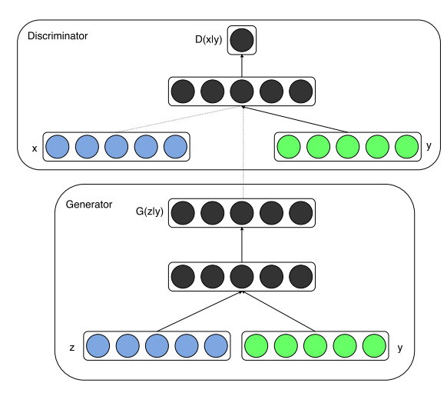
Restricted Multimodal Generative Model
SOTA
Conditional VAE
https://papers.nips.cc/paper/5775-learning-structured-output-representation-using-deep-conditional-generative-models.pdf
Conditional GAN
https://arxiv.org/pdf/1411.1784.pdf
Status
Currently working on (have codes)
Can adapt from previous work (RRNN)
Target ICML (50 days)
Risk: low

Slide 5
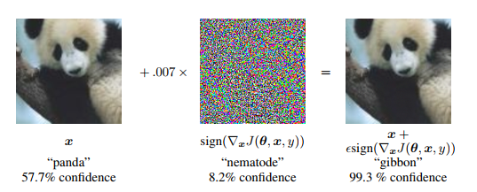
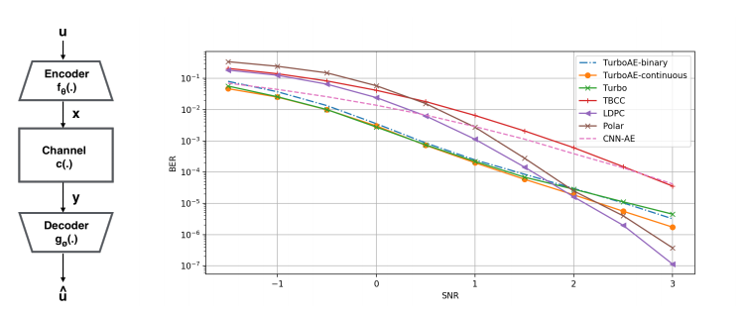
Deep Adversarial Attacks Against Channel Coding
Generate adversarial attacks on (deep) channel coding models
Adversarial Examples
Fast Gradient Sign Method
https://arxiv.org/pdf/1412.6572.pdf
https://arxiv.org/abs/1607.02533.pdf
One Pixel Attack
https://arxiv.org/pdf/1710.08864.pdf
(Deep) Channel coding
Deep Turbo Autoencoder
https://arxiv.org/pdf/1911.03038.pdf
Attack on communication
https://arxiv.org/pdf/1902.08391.pdf

Slide 6
Deep Adversarial Attacks Against Channel Coding
Generate Attack using Deep adversarial method
Targeted vs. Non-targeted
Non-targeted aims to increase BER
Targeted aims to fool decoder to decode a specific information
Whitebox vs. Blackbox
Whitebox knows model architecture and differentiable (suitable for deep turbo autoencoder)
Blackbox assumes decoder not known or not differentiable (suitable for Real work turbo code, LDPC etc.)
Status
Have codes available from both parties
Target ICML (50 days)

Slide 7

Restricted-Federated-Learning
Federated Learning (For data privacy, uplink communication costs, edge computing)
https://arxiv.org/pdf/1610.05492.pdf
https://arxiv.org/abs/1906.08935.pdf (use gradient to recover private data)
Distributed SGD (For large scale fast training)
https://static.googleusercontent.com/media/research.google.com/zh-CN//pubs/archive/45187.pdf

Slide 8
Restricted-Federated-Learning
Restrict each node (worker) to have its own free parameters
Better generality for their own dataset
Better data privacy
Status
Need to use FL package PySyft (https://github.com/OpenMined/PySyft)
Can adapt from previous work (RRNN)
Not sure if it works or not
Target ICML (50 days)

Slide 9
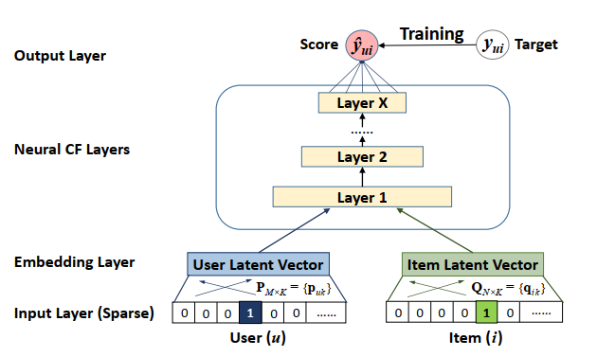
Ultra-personalized-Content-Based-Recommendation-System
A data mining application topic served as multimodal problem
https://towardsdatascience.com/introduction-to-recommender-systems-6c66cf15ada
https://arxiv.org/pdf/1707.07435.pdf
Deep Learning based, content-based (data-driven)
Neural Collaborative Filtering
https://arxiv.org/pdf/1708.05031.pdf
Deep Factor Machine
https://arxiv.org/pdf/1703.04247.pdf

Slide 10
Ultra-personalized-Content-Based-Recommendation-System
Restrict mapping from input data to embeddings
Similar user, items and other fields of data can be considered as modality
Each modal can be modeled in a restricted manner
Status
Online code available for related works
Learning curve for dataset, metrics and other aspects for this topic
Target SIGIR (35 days) or KDD (60 days)

Slide 11
Others
Defend adversarial attacks from intermediate layers
Smart Turbulence (approximate complicated term in differential equation)
Federated Learning through Bottleneck
Learn recurrent models for adapting optimizer step size
Restricted modeling for general language modeling taking advantage of grammatical structure
Generate model from data
Neural Networks on Finite Field

